Slide 1
SMART WASTE MANAGEMENT SYSTEM FOR METROPOLITAN CITIES
DOMAIN : INTERNET OF THINGS
PROJECT ID : PNT2022TMID03917
TEAM MEMBERS
SRIABIRAMI V(TEAM LEAD)
DIVYAA SRI A R
SHYAMALA VARSHINI K
PRIYADHARSHINI K

Slide 2
ABSTRACT
A healthy existence depends heavily on environmental hygiene. In our daily lives, waste bins shouldn't be left unattended. Unattended garbage containers will overflow, leak, and emit pollutants that are hazardous to the health of both people and the environment. Population expansion and huge migrations of residents from urban and semi-urban areas to smart cities have created issues for these cities due to their rapid rise. Handling, collecting, and disposing the everyday trash generation is one of the biggest issues that Metropolitan Areas are up against. It is difficult to gather and process waste on a larger scale. In order to manage and dispose of rubbish effectively, we are creating a smart IOT-based waste management system for metropolitan areas as part of our research.

Slide 3
Problem statement
Large cities nowadays face a common challenge: how to effectively manage garbage without making cities dirty. In today's waste management systems, a big number of people are designated to watch over a specific number of bins; this is done regularly throughout the day. This results in an extremely dirty and inefficient system where some bins will be overflowing and others may not even be half filled. It is impossible to tell which area of the city need urgent attention because of this variation in population density or some other arbitrary element. This article introduces a trash management system in which each bin has a monitoring system built in that will alert the appropriate person when the bin is full. This system provides an effective solution to the waste management problem

Slide 4
EXISTING SYSTEM
Manual systems in which employees clear the bin periodically
No systematic approach towards clearing the bin
Unclear about the status of a particular location
Employees are unaware of the need for a particular location
Very less effective in cleaning city

Slide 5
PROPOSED SYSTEM
In this system, a 24×7 monitoring system is designed for monitoring bins
Here a smart and organized system is designed for selective clearing
The ultrasonic sensor is used for measuring the level of waste in the bin
If either of the containers is full then an alert message is sent from the dumpster
In turn, employees can clear the corresponding bin
All these sensors are connected to an Arduino Uno board

Slide 6
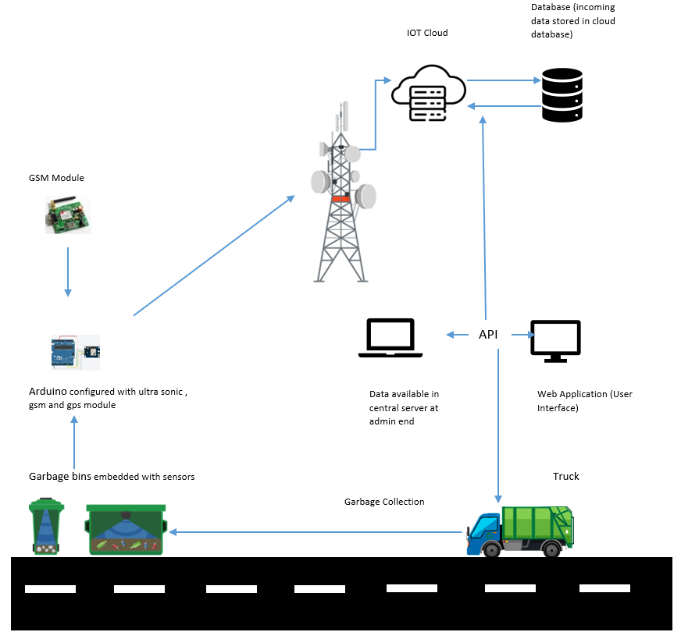
Architecture DIAGRAM

Slide 7
Literature SURVEY
Project Title | Authors | Objective
IOT Enabled Smart Waste Bin with Real Time Monitoring for efficient waste management in Metropolitan Cities | Manju Mohan, Kuppan Chetty Ramanathan | A waste management system by utilizing the concept of IoT to connect the different dust bins at different locations and also to identify the level of waste in a dust bin through a centralized system. Hence, the concerned persons will be notified about each bin status and there by achieving the removal of wastes in a proper way.
Solid Waste Collection as a Service using IoT Solution for Smart Cities | Sangita S. Chaudhari ,Varsha Y. Bhole | There will be multiple garbage bins positioned throughout the city or campus, these garbage bins will be set up with low cost embedded device which helps in tracking the level of garbage in particular bin along with location tracking module to get real time location of bin. All the real time information including garbage level as well as location of that bin will be send frequently to concern authority and garbage collector truck driver as well. The truck driver will have android application which will show real time information about all bins to driver that which bin is how much full and which location in need to graphical form. So he can go directly to place where actually empty the garbage bin to achieve Resource optimization, cost reduction, time management and active participation of truck driver.

Slide 8
A Serverless IoT Architecture for Smart Waste Management Systems | Eyhab Al-Masri, Ibrahim Diabate, Richa Jain, Ming Hoi Lam and Swetha Reddy Nathala | recycle.io, a serverless Internet of Things (IoT) architecture for smart waste management systems. Using recycle.io, it is then possible to determine in real-time the types of source material violations prior to the waste collection. In this manner, waste management systems can identify sources of violations and rectify this by bringing awareness to the public or issuing fines to prevent violations from occurring.
IoT assisted Waste Collection and Management system using QR codes | Aparna H , Bhumijaa B , Avila J, Thenmozhi K , Rengarajan Amirtharaja and Padmapriya Praveenkumar | IoT and smart sensors can be used to manage waste efficiently. Quick Response (QR) codes are used to track and monitor the waste collection procedure. The QR codes are designed to be scanned via an android application, which verifies, stores data and alerts the user. QR codes are used as they are safe and can be printed on any surface and can be scanned easily using smartphones.
Smart City Implementation of Smart Bin Using Raspberry Pi | R.Chawngsangpuii | In this paper, a model of smart IOT-based dustbin using Raspberry Pi for handling sanitation issues related to garbage management system is presented. Since the government has taken many initiatives in developing Smart Cities in India, any Smart City Project will not be complete without having a Smart Garbage Management System. A smart system able to give real-time information about the status of the garbage bin is needed. This system should be able to alert the municipality for cleaning or picking the bin on time, thereby safeguarding the environment and also the health issues of the citizens. For implementing the system, message can be sent to the person authorized for the purpose to gather the garbage from the actual and precise location.

Slide 9
rEQUIREMENTS
Arduino Uno
Ultrasonic Sensor
PIR Motion Sensor
LED
LCD
Python IDE
Wokwi

Slide 10
CONCLUSION
In any large city, this initiative is quite effective at managing waste. Here, a priority system is implemented in place of more traditional periodic collection techniques to ensure that the city is always clean and free of overflowing trash cans.
It has been thoroughly tested and confirmed to ensure that all the various components work together to ensure the efficient operation of the entire system.

Slide 11
THANK YOU !!!

